Slide 1

Chapter Two (c)
CIS - Fundementals of Web Design
Software Engineering Department
College of Engineering and Architecture
Al Yamamah University
Advanced HTML
Instructor: Layla Albabtain Fall 2019

Slide 2
Advanced HTML: Forms 01
A form is the usual way information is gotten from a browser user to a server.
HTML has tags to create a collection of objects that implement this information gathering
The objects are called widgets or controls or components
(e.g., radio buttons and checkboxes)
When the Submit button of a form is clicked, the form’s values are sent to the server for processing.

Slide 3
Example: Forms 01
<!DOCTYPE html>
<html lang="en">
<head>
<title> Forms Example </title>
<meta charset="UTF-8" />
</head>
<body>
<h2>HTML Forms</h2>
<form action="/action_page.php“>
First name:<br>
<input type="text" name="firstname" value=" ">
<br>
Last name:<br>
<input type="text" name="lastname" value=" ">
<br><br>
<input type="submit" value="Submit">
</form>
</body>
</html>

Slide 4
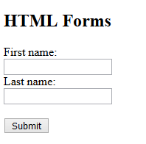
Example - Forms 01

Slide 5
Advanced HTML: Forms Elements
Input.
Select.
Text Area.
Button
HTML5:
Datalist
Output

Slide 6
Advanced HTML: Forms Elements - Input
The most important form element is the <input> element. Many Widgets are created with the <input> tag.
The <input> element can be displayed in several ways, depending on the type attribute. Examples of input types.
text,
passwords,
checkboxes,
radio buttons
Action buttons: Reset, Submit, and plain.

Slide 7
Advanced HTML: Forms Elements - Input (Text)
Creates a horizontal box for text input
Default size is 524288; it can be changed with the size attribute maxlength attribute specifies the maximum number of characters that the browser will accept.
A control and its label can be connected by putting the control and its label in the content of a label element, as in the following element:
<label> Phone: <input type = “text” name = “phone” /> </label>
Separated label and control:
Phone: <input type = “text” name = “phone” />
For password field, we can use password input type. In password field asterisks/dots are displayed, rather than the input characters.

Slide 8
Example: Forms Elements - Input (Text)
<!DOCTYPE html>
<html lang="en">
<head>
<title> Forms Text and Password Example </title>
<meta charset="UTF-8" />
</head>
<body>
<h2>HTML Forms</h2>
<form action="/action_page.php">
UserName:
<input type="text" name="firstname" value=" ">
<br>
Password:
<input type="password" name="lastname" value=" ">
<br><br>
<input type="submit" value="Submit">
</form>
</body>
</html>

Slide 9
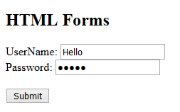
Example: Forms Elements - Input (Text)

Slide 10
Advanced HTML: Forms Elements - Input (Checkbox)
Used to collect multiple-choice input from the user.
A checkbox control is a single button that is either on or off (checked or not).
If a checkbox button is on, the value associated with the name of the button is the string assigned to its value attribute.
A checkbox button does not contribute to the form data if it is off.
Every checkbox button requires a name attribute and a value attribute in its <input> tag.

Slide 11
Example: Forms Elements - Input (Checkbox)
!DOCTYPE html>
<html>
<body>
<h2>Checkboxes</h2>
<p>The <strong>input type="checkbox"</strong> defines a checkbox:</p>
<form action="/action_page.php">
<input type="checkbox" name="console" value="PS4">I have a PS4
<br>
<input type="checkbox" name="console2" value="PS4">I have a PS4
<input type=“checkbox” name=”console2” value=“PSVITA”> I have playstation Vita.
<br><br>
<input type="submit">
</form>
</body>
</html>

Slide 12
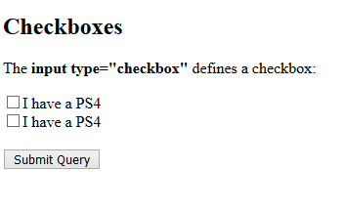
Example: Forms Elements - Input (Checkbox)

Slide 13
Advanced HTML: Forms Elements - Input (Radio)
collections of checkboxes in which only one button can be ‘checked’ at a time
Every button in a radio button group MUST have the same name.
<!DOCTYPE html>
<html lang="en">
<head>
<title> Forms Text and Password Example </title>
<meta charset="UTF-8" />
</head>
<body>
<h2>Radio </h2>
<h3> Gender </h3>
<form action="/action_page.php">
<input type="radio" name="gender" value="male" checked> Male <br>
<input type="radio" name="gender" value="female"> Female
</form>
</body>
</html>

Slide 14
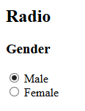
Example: Forms Elements - Input (Radio)

Slide 15
Advanced HTML: Forms Elements - Select
There are two kinds of menus, those that behave like checkboxes and those that behave like radio buttons (the default).
Menus that behave like checkboxes are specified by including the multiple attribute, which must be set to "multiple".
The name attribute of <select> is required.
The size attribute of <select> can be included to specify the number of menu items to be displayed (the default is 1).
Each item of a menu is specified with an <option> tag, whose pure text content (no tags) is the value of the item
An <option> tag can include the selected attribute, which when assigned "selected" specifies that the item is preselected.
Please refer to LMS for Select example.

Slide 16
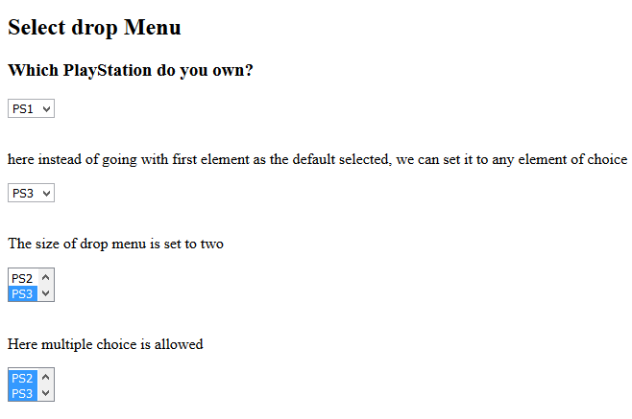
Example: Forms Elements - Select

Slide 17
Advanced HTML: Forms Elements - Text Area
created with <textarea>
Usually include the rows and cols attributes to specify the size of the text area.
<body>
<h2> Text Area </h2>
<h3> Describe your experience? </h3>
<p>
<textarea name="experience" rows="3" col="40">
please describe your experience with VR.
</textarea>
</p>
</body>

Slide 18
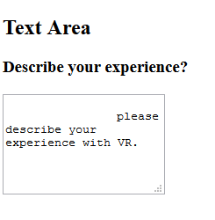
Example: Forms Elements - TextArea

Slide 19
Advanced HTML: Forms 02
All of the Elements, or components of a form are defined in the content of a <form> tag.
The only required attribute of <form> is action, which specifies the URL of the application that is to be called when the Submit button is clicked.
The method attribute of <form> specifies one of the two possible techniques of transferring the form data to the server, get and post.
The default is get.
To use post, the method attribute should be used and assigned post:
<form action="/action_page.php" method="POST">

Slide 20
Advanced HTML: HTTP
What is HTTP?
The Hypertext Transfer Protocol (HTTP) is designed to enable communications between clients and servers.
HTTP works as a request-response protocol between a client and server.
A web browser may be the client, and an application on a computer that hosts a web site may be the server.
Example: A client (browser) submits an HTTP request to the server; then the server returns a response to the client. The response contains status information about the request and may also contain the requested content.

Slide 21
Advanced HTML: HTTP Methods
GET.
POST.
PUT.
HEAD.
DELETE.
PATCH.
OPTIONS.

Slide 22
Advanced HTML: HTTP - Get Method
GET is used to request data from a specified resource.
GET is one of the most common HTTP methods.
The browser attaches the query string to the URL of the HTTP request, so the form data is transmitted to the server together with the URL.
The browser inserts a question mark at the end of the actual URL just before the first character of the query string so that the server can easily find the beginning of the query string.
Example: /test/demo_form.asp?name1=value1&name2=value2
Another example.

Slide 23
Advanced HTML: HTTP - Get Method
GET requests can be cached.
GET requests remain in the browser history.
GET requests can be bookmarked. It is useful for form submissions where a user wants to bookmark the result.
GET requests have length restrictions. The length of a URL is limited (about 3000 characters).
GET requests is only used to request data (not modify).
GET requests should never be used when dealing with sensitive data. It is better for non-secure data, like query strings in Google. Why?!
Because the data will appear in the URL, can be cached and can be found in history

Slide 24

Advanced HTML: HTTP - POST Method
POST is used to send data to a server to create/update a resource.
POST is one of the most common HTTP methods.
POST requests are never cached.
POST requests do not remain in the browser history.
POST requests cannot be bookmarked.
POST requests have no restrictions on data length.
POST has no size limitations, and can be used to send large amounts of data.
The data sent to the server with POST is stored in the request body of the HTTP request.

Slide 25
Resources
W3 School.

